Slide 1


GaPSC Updates
GAEL, January 2025
GADA
11-14-25

Slide 2

Senate Resolution 237
Strategic Plan for Educator Recruitment and Retention
in Georgia

Slide 3


Slide 4
AI Ethical Guidance
A Guidance document Ethical Principles in the Appropriate Use of AI for Educators is posted on the website of the Georgia Professional Standards Commission (GaPSC) at www.gapsc.com.
Go to the Resources section of the Ethics Tab at www.gapsc.com. The direct link is GaPSC Ethical Considerations in the Appropriate Use of AI for Educators_6-16-25.pdf.
Also posted are Social Media and Remote Learning Guidelines.

Slide 5
AI Ethical Guidance Position Statement
GaPSC:
Recognizes the profound potential of AI to enhance teaching, learning, and operational effectiveness within Georgia's educational communities.
Acknowledges the critical importance of ethical, professional, and legal responsibilities associated with the integration of AI tools in educational settings.
Committed to providing ethical guidance that fosters the responsible use and helps prevent and mitigate the harmful use of AI in support of student learning, professional practice, and public trust.

Slide 6
AI Ethical Guidance Purpose
  This Guidance document is intended to serve as voluntary statewide guidance for Georgia P-12 educators, administrators, and staff regarding the use of AI in schools and classrooms.
  School districts, individual schools, and educator preparation providers (EPPs) may adopt or adapt it for local use. The goal is to empower educators and students to use AI as a supplement to, not a substitute for, core human-centered teaching and learning.
  This Guidance is not an attempt to prohibit or regulate AI tools or development, but rather to enhance appropriate human use.

Slide 7
AI Ethical Guidance Structure
  The Guidance consists of and introduction and seven principles, each of which has standards and guiding questions.
  Introduction
    Purpose
    Definition
    Audience
    Guidance Structure
    What the Guidance Is and What it is Not
    Important Understandings
    Implementation
    Ways to Use

Slide 8
AI Ethical Guidance Principles
  Principle #1: When AI tools are used in the classroom, educators and/or staff have an obligation to ensure they are being used responsibly and ethically.
  Principle #2: Administrators, educators, and staff have a responsibility to model and teach the ethical, responsible use of AI and to mitigate the risk of misuse that undermines academic integrity or threatens the well-being of students and staff.
  Principle #3: When using AI, educators, administrators, and staff have a responsibility to proactively protect the personally identifiable information entrusted to them.
  Principle #4: Administrators, educators, and staff should apply professional practice in evaluating, selecting, and using AI tools, aligned with all relevant laws, regulations, policies, and guidelines.

Slide 9
AI Ethical Guidance Principles
  Principle #5: Educators, administrators, and staff have a responsibility to clearly and transparently communicate the use of AI in instructional and administrative practices.
  Principle #6: Educators, administrators, and staff have a shared responsibility to use best practices to understand and help mitigate bias in AI tools and potential results.
  Principle #7: Due to the rapid pace of AI development, educators, administrators, and school staff have a responsibility to stay informed about the capabilities, risks, and ethical considerations of AI, and to effectively communicate any concerns
Available at
GaPSC Ethical Considerations in the Appropriate Use of AI for Educators_6-16-25.pdf.

Slide 10
Currently Available Ethical Use of AI Materials:
  GaPSC Position Statement
  AI Guidance Document
    Introduction
    Seven Principles
    Objectives for each Principle
    Guiding Questions for each Principle
  Guidance Survey
  Coming Soon:
  Instructional Videos on Each Principle

Slide 11
GaPSC Reminders
Please share:
GaPSC’s Notice of Proposed Rulemaking is available at https://www.gapsc.com/Commission/Rules/home.aspx. Public comment on the currently proposed rules closes 11-29-25.
Please help us process certificates as quickly as possible for you and your educators by only submitting complete applications. Please hold all applications until you have all the required documentation ready to submit.
EPPs will be granting eligibility for initial teaching candidates to attempt the appropriate Literacy Assessment, in addition to granting separate eligibility for the content assessment. TPMS and NTRS are being modified to reflect this change, which will be available once the technology and materials are in place.
The GACE Data Matching verification period dates for Title II/HEOA will be announced as soon as available.

Slide 12
GaPSC Reminders
Please share:
The GACE data point of contact for each EPP will receive information about the GACE Scholarship Vouchers. Please use these.
The next Help Session for the GACE Results Analyzer tool is November 20, 2025, 1pm-2pm.
GaPSC’s Certification and Program Officials’ Conference will be held virtually, December 4-5, 2025.
The School Safety and Anti-Gang Endorsement is available to all employees, not just educators. The endorsement is designed to provide educators and school personnel with online and in-person training in multidisciplinary best practices for promoting and preserving safe schools and for identifying and deterring youth gangs.

Slide 13
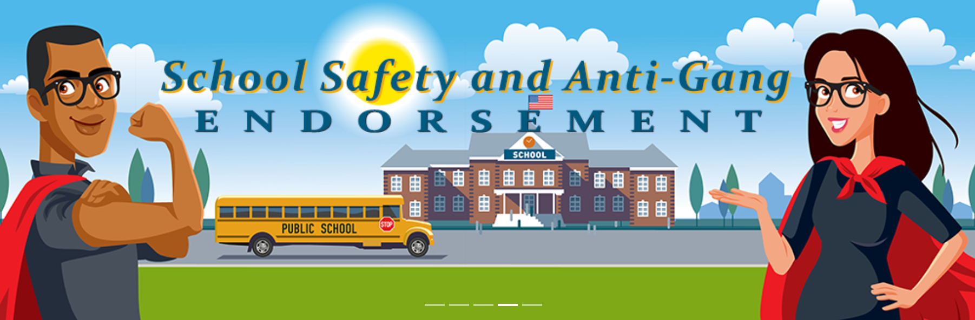
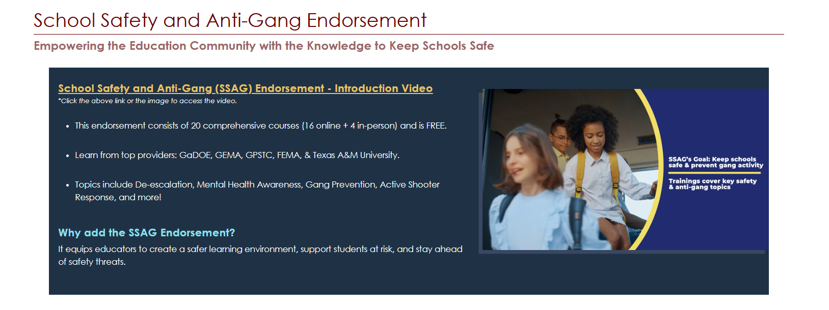
Reminder
https://www.gapsc.com/Certification/SchoolSafetyandAntiGangEndorsement.aspx

Slide 14

GaPSC Highlights: Please Share

Slide 15




Stay Connected
https://www.gapsc.com

